Slide 1

Sehhaty app

Slide 2
Introduction
Health is of great importance in human life, and achieving and achieving goals requires a healthy person who is able to face anything that stands in his way. Just as physical health is important to mental health, vitamins are also among the most important causes of mental health. That is why there should be an application to help you maintain health and receive reports about your body on your phone.

Slide 3
The Problems
Most people don't want to go to the hospital for a simple reason, many people don't want to go to book an appointment with the doctor because sometimes they are busy or the hospital is far away from him.

Slide 4
Background
Sehhaty is an electronic platform of health services for individuals in Saudi Arabia. Sehhaty aims to enable users to reach health information and medical e-services provided by different health organization.

Slide 5
Proposed solution
Sehhaty app came with the option to take a appointments with different doctors in different hospitals.

Slide 6
Work plan
If I was the programmer of the app I would add more choices for the user such as a video call or a chat for the appointment , and a list contain your appointments with a report for each one , also a notification with a healthy advice every day.

Slide 7
Projact requiermants

Slide 8
Functional requierments
Login – the user shall login into the app by write his id and password.
Notifications - the system shall inform the customer before his appoiment or when he recive a report from his doctor.

Slide 9
Functional requierments
Search –the asystem shall allow the user to search in search box for a section or a specific doctor by his name .
Doctor info – the system shall show the info of doctor for patients.

Slide 10
Functional requierments
Sections – the system shall allow the user to section that he want.
Appointments reports – the system shall allow the doctor to sent the reports to the user .

Slide 11
Functional requierments
Database – system database shall contain all info about users.
Chat – the system shall contain a chat between the patients and the doctor for answer his question.

Slide 12
Non-Functional requierments
Availability – app availability 27/4.
Security – the app should keep the information safe and log out the user auto.

Slide 13
Non-Functional requierments
Usability – ease of use .
Accessability – the app should have many languages .

Slide 14
Activity digram

Slide 15
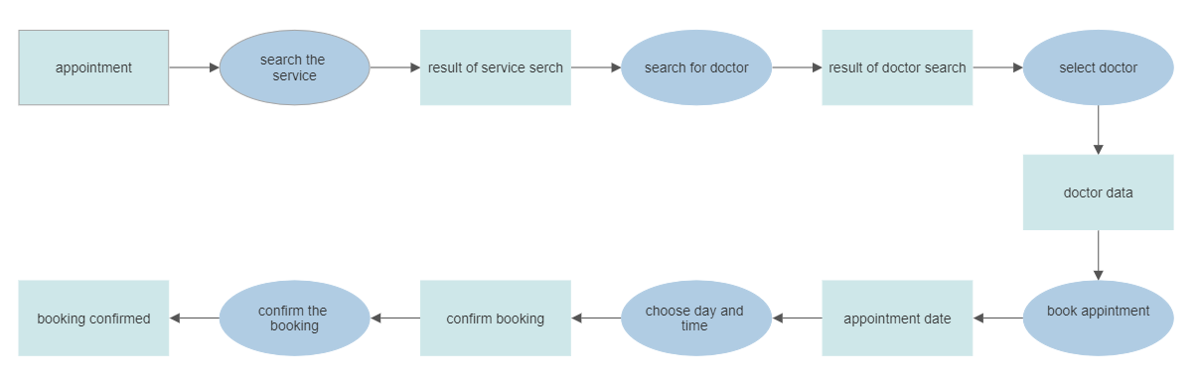

Slide 16
Project use case modeling

Slide 17
Actors
patient – doctors –
appointments manegars in hospitals.

Slide 18
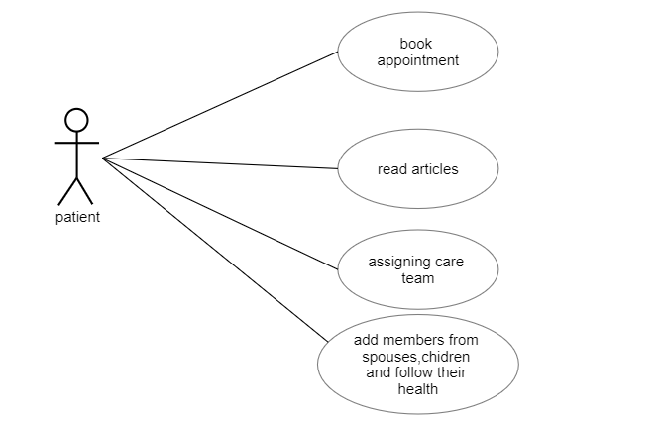
Use case:

Slide 19
assigning care team

Slide 20
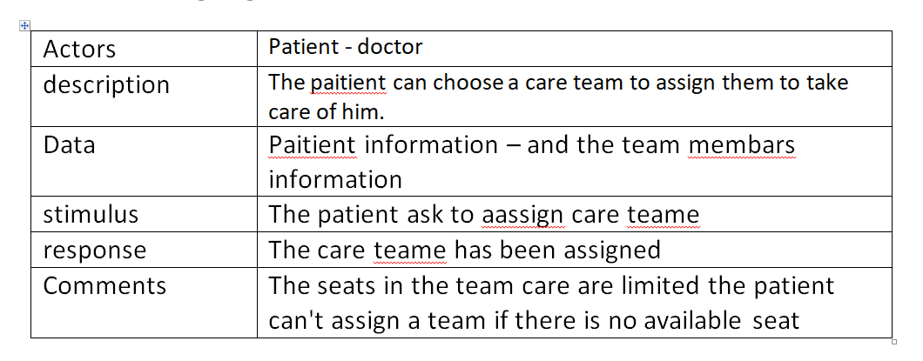

Slide 21
Book appointment

Slide 22
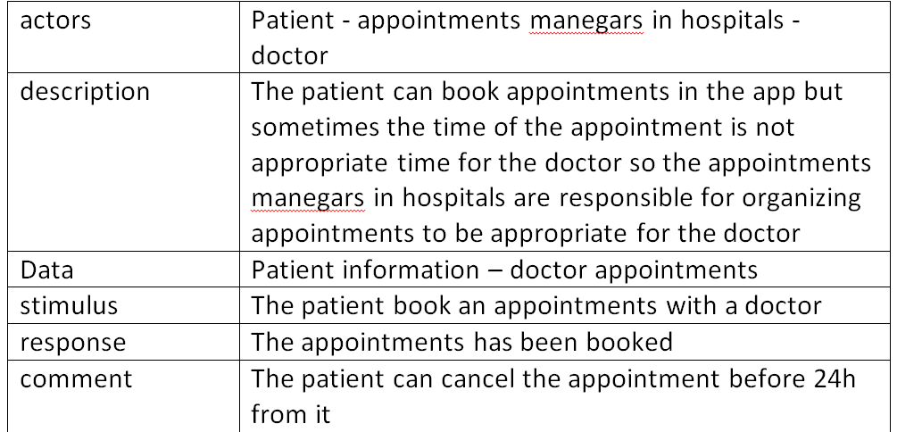

Slide 23
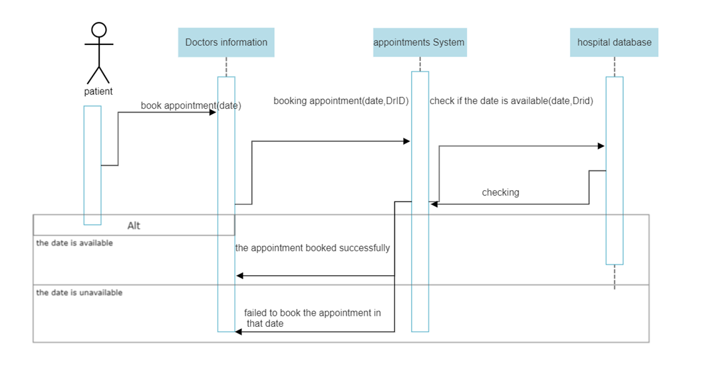
Sequence Diagrams

Slide 24
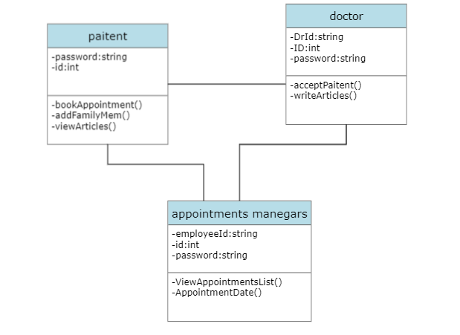
Class digram

